Slide 1
Conflict minerals in the Democratic Republic of Congo

Slide 2
Pre-Colonization
Bantu-speaking people settled in Congo in mid 7th-8th centuries
From 14th-19th centuries, part of Congo, Luba, and Kuba Kingdoms.
Portuguese engaged in slave trade in Congo during mid 1400’s

Slide 3
Colonization
1870’s King Leopold II of Belgium claimed the Congo
Made official by Berlin Conference, where European powers divided up Africa in order to avoid conflict
Divisions ignored tribal boundaries

Slide 4
Map questions: 1) What are two CLAIMS you can make using the map? 2) What are two questions the map does not answer?

Slide 5
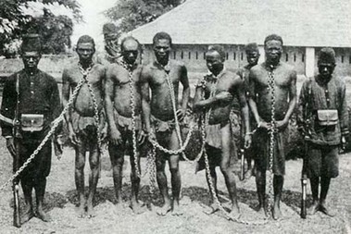
Belgian rule 1870’s-1960
Officially ruled by King Leopold II from 1875-1908. Leopold used the resources of the territory for financial gain, especially exploiting the supply of rubber trees using what amounts to slave labor
Ruled by Belgian government from 1908-1960. During this time there was a lack of formal education, with the Congolese people being prevented from any university education beyond a religious one
Chained Congolese slaves on a Belgian Rubber Plantation

Slide 6
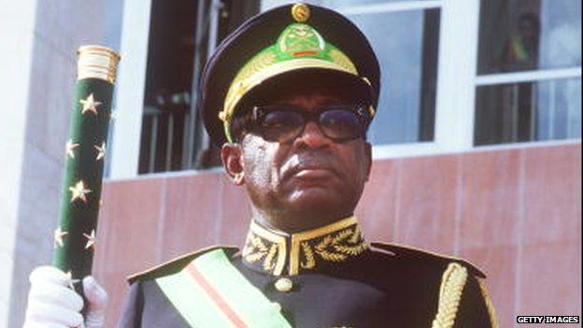
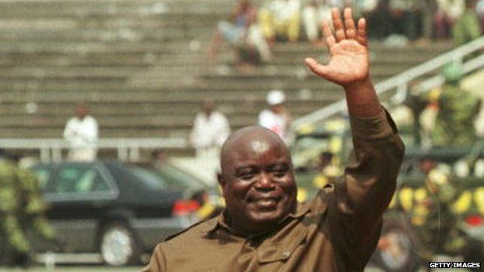
Post colonialism
History of violence and dictatorship. Ruled by Colonel Joseph Mobutu from 1965 until he was overthrown by Laurent-Désiré Kabila in 1997.
Laurent-Désiré Kabila ruled until his assassination in 2001. His son, Joseph Kabila, ruled country from 2001-2018.
2019: Officials declare opposition candidate Felix Tshisekedi the winner of December's presidential election, prompting protests from rival opposition candidate Martin Fayulu of a deal with the government, whose candidate Emmanuel Ramazani Shadary came third.
Colonel Joseph Mobutu
Laurent-Désiré Kabila

Slide 7
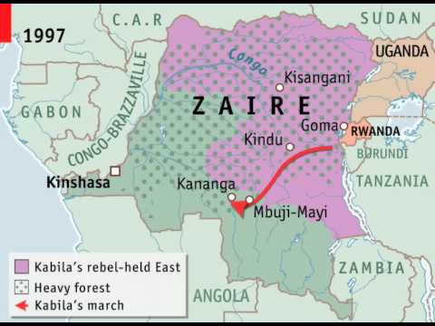
Congo Wars
The International Rescue Committee said that between August 1998 and April 2004 some 3.8 million people died in the 2nd Congo War.
First Congo War
Second Congo War/ Great War of Africa
October 1996-May 1997.
Started in 1996 as Congolese fought to expel Hutu refugees from the country (Hutu power groups were responsible for a genocide in Rwanda that killed 800,000 Tutsi people)
Resulted in an overthrow of Congolese government, with Laurent-Désiré Kabila coming to power
Second Congo War August 1998- July 2003
Kabila turned against Rwandan and Ugandan forces that supported him and allowed Hutu rebel groups to regroup in the Eastern part of Congo
During the five-year conflict Congolese forces, supported by Angola, Namibia, and Zimbabwe faced rebels and soldiers backed by Uganda and Rwanda.

Slide 8
Congo today: Armed rebel groups
Eastern and Southern Congo is controlled by over 100 armed rebel groups

Slide 9
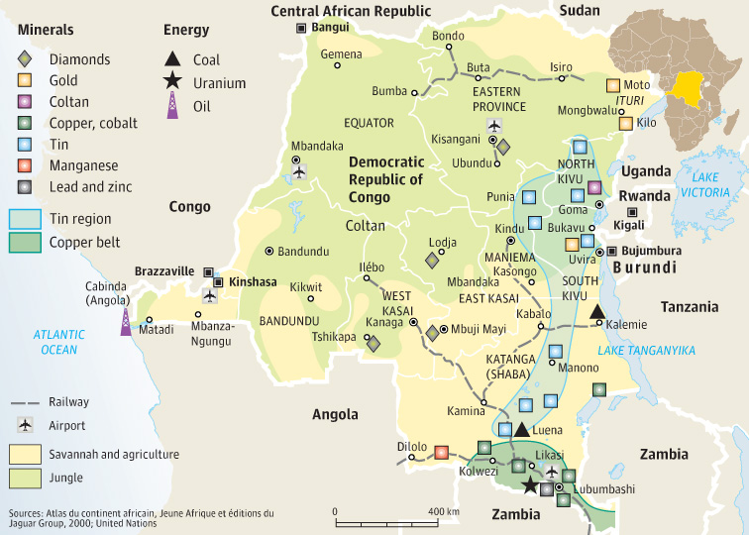
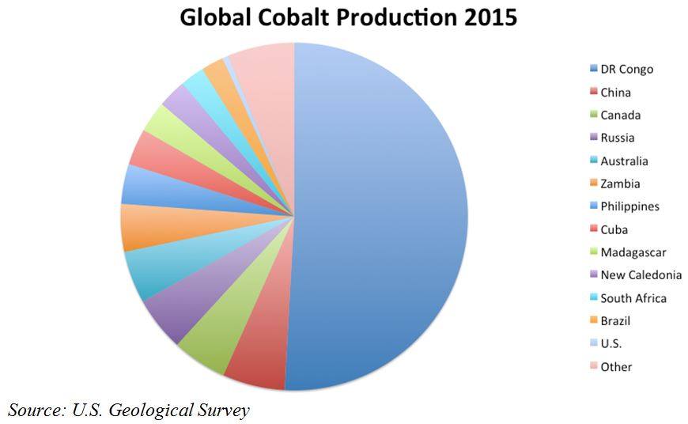
Congo today
Congo is a resource-rich nation
Estimated 60% of the world’s cobalt, an ingredient essential to batteries for phones, computers, and electric cars.
2nd largest supply of diamonds

Slide 11
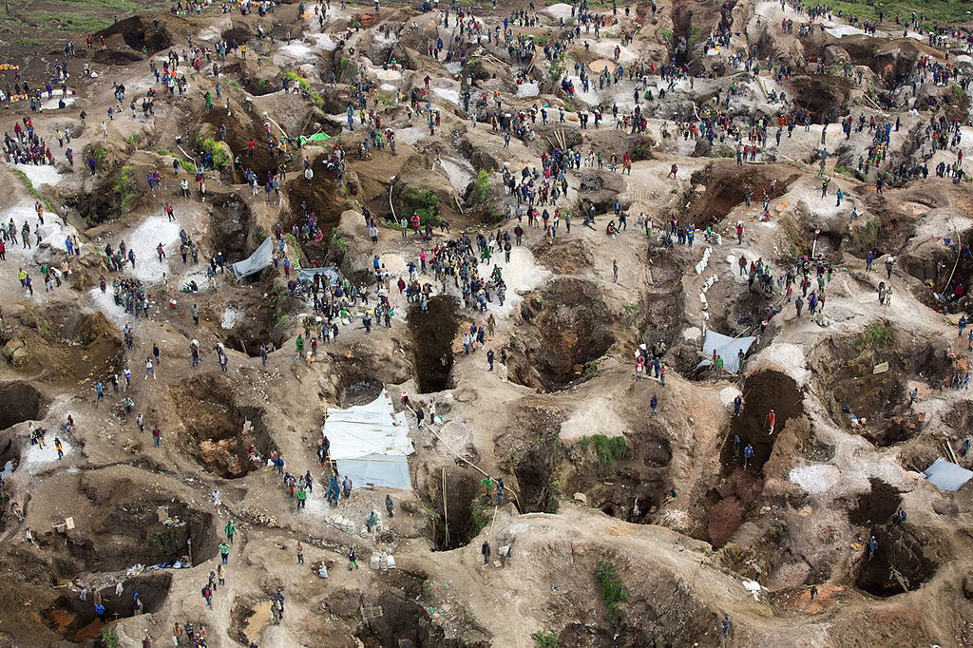
Cobalt mining
Mining accounts for over 80% of the DRC’s earnings
Average citizen in DRC earns around $700 per year (in America average is around $56,000 per year)
Demand (and therefore price) of Cobalt continues to rise, but DRC as a whole is not benefiting from this phenomenon
At least 20% of Cobalt is mined by local miners, including children. Rest by large foreign companies

